Slide 1
Methods of Identifying Inpatients with Hypercapnia for Research Research In Progress 3/2/23
Brian Locke, MD
3rd Year Pulmonary and Critical Care Fellow
University of Utah
University of Utah T32 PI: Paine
Masters of Science in Clinical Investigation
ATS ASPIRE Program
Mentorship Team:
Krishna Sundar MD (PCCM/Sleep)
Ram Gouripeddi MBBS MSc (Bioinformatics) Jeanette Brown MD PhD (PCCM)
Rob Paine III MD (PCCM)
Wayne Richards BSc (Bioinformatics)
Notes:
Origin of this research: biggest gap I noticed was that we often didn’t know what to do on discharge for patients like this.
Particularly under-represented given the problems of obesity, respiratory depressant medications, and multimorbidity.
P_{A}O₂ = FiO₂ (P_{B}-47)—(PaCO₂/R)
→ O₂ 17.8 mmHg lower at 4500ft
relatively early in the lifecycle of this project and so it would be extremely valuable to me to have any feedback or redirection from folks who have obviously thought about this subject quite a lot

Slide 2
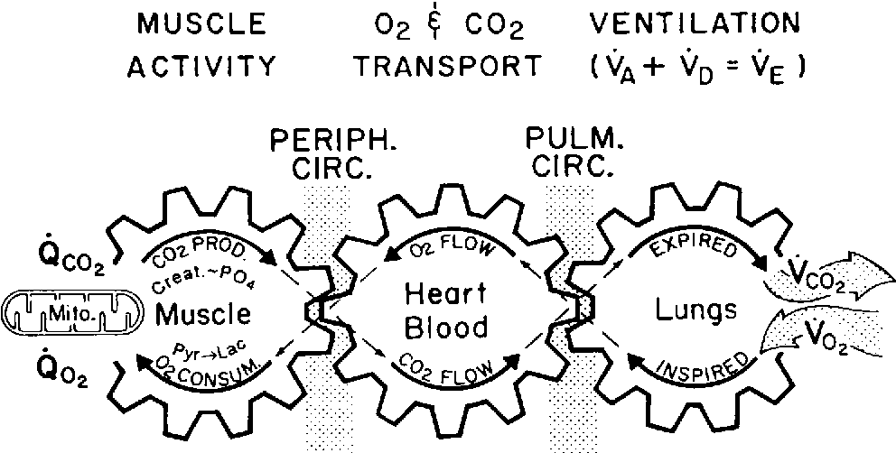
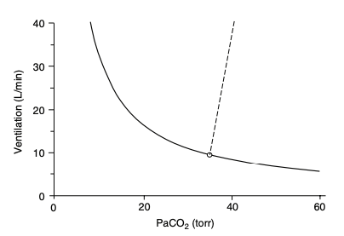
Hypercapnic Respiratory Failure: ’Syndrome’
Definition: PaCO2 too high (> 45 mmHg)*
Key physiologic principles:
Occurrence of CO2↑ : Ventilatory Control or Actuator Frailty?
Metabolic parabola means those with hypercapnia are more prone to decompensation
Many patients are first identified during decompensation:
higher risk for morbidity
also, more available data
Acute management effective, but what should happen after the admission?
Build up here = CO2 in blood rises
Notes:
Definition of a syndrome – set of findings that occur together to suggest a common cause or management.
CO2 retention (hypercapnia) results from inadequate alveolar ventilation relative to metabolic rate
‘V̇A, the volume of gas mobilized in the lungs, per unit of time, contributing to the pulmonary gas exchanges’
‘Ventilatory failure occurs when respiratory muscle capacity is reduced, the load on respiratory muscles is increased or central drive is reduced.’
“The capacity to oxygenate and ventilate actively metabolizing tissue depends
upon three key factors: prudent regulation, reserve capacity, and tissue adaptability
to any sustained shortfall” Marini DOI: 10.1097/CCM.0000000000005022
Hypercapnia Graphic
Wasserman, Karlman, et al. "Principles of exercise testing and interpretation." Journal of Cardiopulmonary Rehabilitation and Prevention 7.4 (1987): 189.

Slide 3
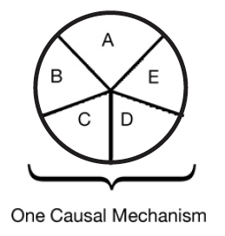
Proposed framework: Sufficient vs Component Causes (Rubin)
Hypothetical patient with hypercapnic respiratory failure
Sufficient cause: a set of factors that will cause disease when present
End-stage COPD with hyperinflation
Component cause: a factor that, if not present, no disease would occur
Untreated OSA, metabolic alkalosis, chronic opiate use
COPD
Obesity
Loop diuretic
Untreated
Sleep Apnea
Opiates
Notes:
Necessary cause: in all sufficient sets, this component must be present
“Perhaps the most important of these principles is self-evident from the model: A given disease can be caused by more than one causal mechanism, and every causal mechanism involves the joint action of a multitude of component causes”’
“The importance of multicausality is that most identified causes are neither necessary nor sufficient to produce disease. Nevertheless, a cause need not be either necessary or sufficient for its removal to result in disease
prevention. If a component cause that is neither necessary nor sufficient is blocked, a substantial amount of disease may be prevented."
Rothman and Greenland

Slide 4

COPD
Trial Data
+Guidelines
Wait 2-4 wks
Overlap Sydnrome
Observational Data
???
Undifferentiated
No tx data
Limited epi data
OHS
Observational Data
+Guideline
Start Immediately
COPD, Very Severe
COPD, mod severe
AHI 50 events/hr
COPD, mod severe
AHI 10 events/hr
Met. Alk loop diur
BMI 45 kg/m2
AHI 50 event/hr
PaCO2 52 mmHg
PaCO2 50 mmHg
PaCO2 50 mmHg
PaCO2 50 mmHg
Swap any combination of:
Muscular weakness
Obesity
Opiate use
Lung disease
Etc.
Post-Admission for Hypercapnic Respiratory Failure Management
Notes:
Not safe to generalize

Slide 5
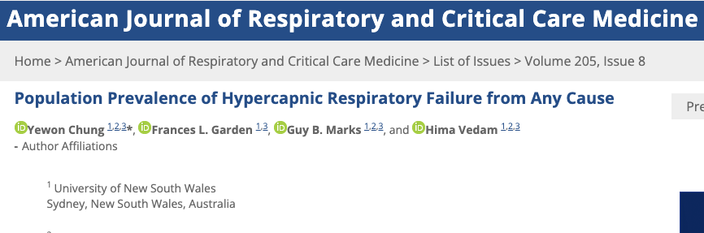
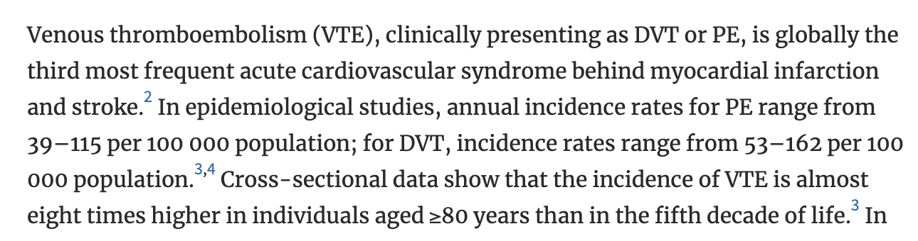

How common are admissions with hypercapnia?
2022: Liverpool AUS, 1 regional hospital services the entire district
Identified by initial ABG (w/n 24h) PaCO2 over 45, excluded iatrogenic causes/sedation. N=891 people, 1135 blood gasses (repeat hosp.)
Normalized rates of hypercapnia to population demographics
150 per 100,000 person/year
Acidosis in 55%.
For Comparison:

Slide 6
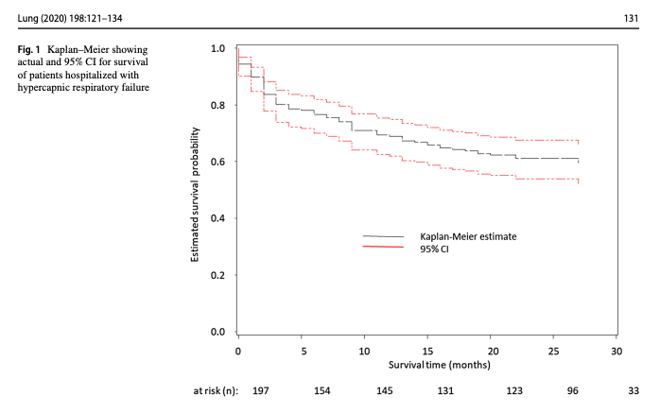
Admissions with Hypercapnic RF → High Risk of Readmission
Admitted to hospital (Floor or ICU) with billing code for Hypercapnic Respiratory Failure
Notes:
Exclusion of other causes of hypoventilation
Obesity -> increased CO2 production and vent limitation from mass of chest wall and disadvantaged respiratory mechanics
“Other Causes”: Obstructive lung disease, neuromuscular / chest wall disease, things that suppress ventilatory drive (opiates), or causes of metabolic alkalosis (loop diuretics)
Likely routine to you all, but this is often botched in pulmonary and inpatient medicine.
Exclusion parameter
In research studies: A patient with mild COPD cannot have OHS. In reality – what do you do with a patient who has COPD so mild that it doesn’t cause OHS? Or, if it’s mild enough that it wouldn’t cause hypercapnia on it’s own? Open questions, problem with the paradigm.
“Exclusion of other causes of hypoventilation
Severe obstructive respiratory disease
Severe interstitial lung disease
Severe chest-wall disorders (eg, kyphoscoliosis)
Severe hypothyroidism
Neuromuscular disease
Congenital hypoventilation syndromes”

Slide 7
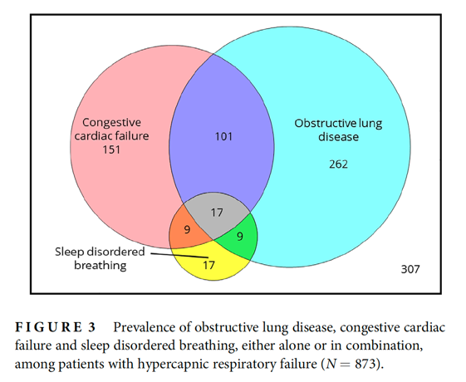
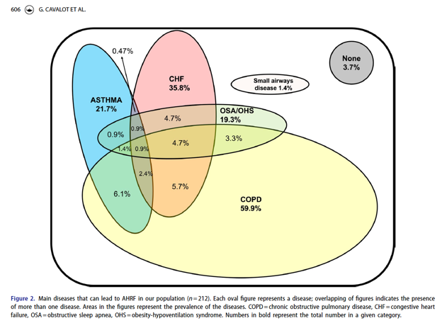
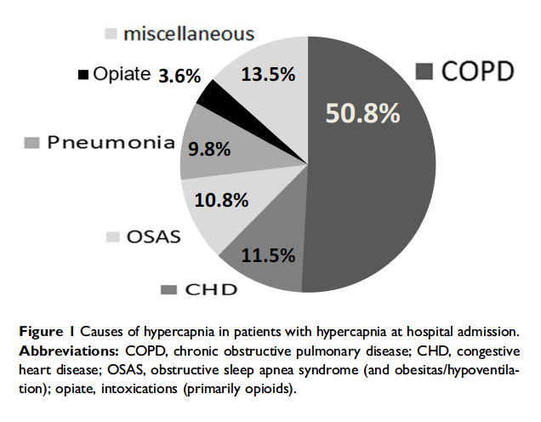
Who are “all-comers admitted with hypercapnia”?
All patients with dyspnea or pulm disease admitted to hospital received capillary blood gas (some screening with VBG). Stratified by pH > 7.35 or pH < 7.35
Hospital specializing in lung disease (unclear referral pattern):
All adult ED visits @ single Toronto ED w ABG <7.35/45+ OR VBG <7.34/50+ & CEDIS resp code for resp symptoms. Charts reviewed for 12 months.
Liverpool AUS: ABG w/n 24h of admission.
Diagnostic codes: 52% Charlson Comorbidity 5+; Prevalence-based estimates: NMD under-represented
Chung Y, Garden FL, Marks GB, Vedam H. Causes of hypercapnic respiratory failure and associated in-hospital mortality. Respirology. 2022
Giulia Cavalot, Vera Dounaevskaia, Fernando Vieira, Thomas Piraino, Remi Coudroy, Orla Smith, David A. Hall, Karen E. A. Burns & Laurent Brochard (2021) One-Year Readmission Following Undifferentiated Acute Hypercapnic Respiratory Failure, COPD: Journal of Chronic Obstructive Pulmonary Disease, 18:6, 602-611
Vonderbank S, Gibis N, Schulz A, Boyko M, Erbuth A, Gürleyen H, Bastian A. Hypercapnia at Hospital Admission as a Predictor of Mortality. Open access emergency medicine : OAEM 2020; 12: 173-180.

Slide 8
What is the role of sleep-disordered breathing?
10.8% OSAS
5% dx’d obesity; 6% dx’d OSA
Chung Y, Garden FL, Marks GB, Vedam H. Causes of hypercapnic respiratory failure and associated in-hospital mortality. Respirology. 2022
OSA/OHS – 19.3%
Retrospective Reviews: mirrors what rate these are diagnosed (not what rate they present)
Giulia Cavalot, Vera Dounaevskaia, Fernando Vieira, Thomas Piraino, Remi Coudroy, Orla Smith, David A. Hall, Karen E. A. Burns & Laurent Brochard (2021) One-Year Readmission Following Undifferentiated Acute Hypercapnic Respiratory Failure, COPD: Journal of Chronic Obstructive Pulmonary Disease, 18:6, 602-611
Vonderbank S, Gibis N, Schulz A, Boyko M, Erbuth A, Gürleyen H, Bastian A. Hypercapnia at Hospital Admission as a Predictor of Mortality. Open access emergency medicine : OAEM 2020; 12: 173-180.

Slide 9
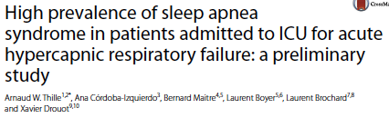
What is the role of sleep-disordered breathing?
 | COPD (66%) | No COPD (33%)
AHI Median [IQR] | 31.9 [14.3, 45.6] | 66.0 [48.0, 83.8]
AHI > 15 present | 66% | 94%
AHI > 30 present | 51% | 81%
& No prior OSA Dx
Overall prevalence of severe OSA ( AHI > 30 ) in survivors over 50%
N=36 survivors of hypercapnia; n=16 agreed to PSG. 56% with AHI > 30 /hr
Notes:
https://www.atsjournals.org/doi/pdf/10.1164/rccm.201608-1666OC
x[ ] Review details
Admitted to ICU to 1 ICU in Tunisia 2015-2018, PaCO2 > 6kpa = 45 mmHg, pH < 7.35. No prior OSA syndrome diagnosis.
make the point that the reverse probabilities are difficult to reason about: likelihood of a given person with OSA needing ICU care? Low. Likelihood of a given person needing ICU care having OSA? High (if that ~50% study is to be believed, severe OSA = at least 10 fold increase)
Is 50% beyond the treatment threshold for CPAP?

Slide 10
Needs: initial decompensation → treatment
Presentation With Hypercapnia
Hypercapnia is common, highly morbid, and likely increasing in frequency (obesity, opiates, multimorbidity)
Correctly Recognized?
Inpt Hypercapnia is frequently missed in practice
Marik, JICM 2012: 75% miss rate.
Nowbar, AJM 2004
Causes Correctly Diagnosed?
Many patients do not receive definitive testing
OSA in 5-15% vs 50-80%
Is there data to guide treatment?
We don’t know what to do for many (most?) patients with hypercapnia
No good estimate? (NMD/Rest, COPD, OHS, OVS)
Is it logistically possible?
Device qualification restrictions.
No good estimate?
Does it happen?
Requires coordination between Inpt → Outpt. Consider CHF (CMS f/u after discharge)
No good estimate?
Notes:
Patients prone to ventilatory decompensation are not currently systematically identified or managed, and so frequently fall through the cracks. Identification and treatment of sleep disordered breathing and its risk factors is a promising approach to improve care but requires empiric support to justify implementation.
Motivation for the research Dash systematized, identification, and assessment, with a battery of a valuations is likely to lead to a large improvement in readmission. Include this as the reason to do this research. It’s needed because this is common and commonly missed and highly morbid.
[x] https://onlinelibrary.wiley.com/doi/10.1111/resp.14413 editorial on hypercap epidemiology.. highlights need for better methods than ABG to identify. This can be a key citation.
“Tertiary prevention refers to the action taken to reduce the chronic effects of a health problem in an individual or a population by minimizing the functional impairment consequent to the acute or chronic health problem”
My vision: someone comes in with hypercapnia - they are identified as someone who for some reason has frailty of their ventilatory control or performance and thus at high risk of future adverse outcomes. This triggers a number of assessments to identify the causes for this frailty, and triggers a pipeline for respiratory care (both diagnostic studies and outpatient treatment.
Current reality: referral to sleep medicine in placed. They receive steroids, antibiotics, diuretics and slowly improve. They are sent home on oxygen and bounce back.
Why are we doing it?
Prevalence if hypercapnia is likely rising: Obesity, Opiates, Multi-morbidity
What are the most common component causes? Not known
Existing evidence pertains to well-defined populations that do not reflect clinical practice
No consensus exists around how to systematically identify, nor manage these patients after stabilization.
HUGE room for improvement in processes of care, but evidence is required.

Slide 11
Computable phenotypes: algorithms to identify specific patient cohorts
Problems with retrospective EHR-based research:
Missing Data
Time/Event determination (immortal time)
Observational nature (residual confounding; multiple comparisons)
Disease Identification
Contrast: Cohort study with assessment and verification of diagnostic labels. Particularly, respiratory diagnoses (Asthma, COPD, OHS, OSA)
Precise definitions (phenotypes) can help with patient identification
Simple: Inclusion criteria to a study
Complex: use additional data elements (demographics, meds), natural-language processing, etc.
Notes:
(https://www.bmj.com/content/341/bmj.c4226.extract)
Nissen F, Quint JK, Morales DR, et al. How to validate a diagnosis recorded in electronic health records. Breathe 2019; 15: 64–68.
Data elements that would be useful for research can therefore be wrongly classified, insufficiently specified or missing.
Misclassified data can lead to systematic measurement errors.
Missing data can lead to selection bias and counteract the statistical power provided by the magnitude of EHR
Whether the codes in an EHR database accurately capture the target condition (and thus minimize measurement errors) strongly affects the reliability of subsequent observational studies
10. Wong M, Day NE. Validation studies in epidemiology:
the relative precision of different designs. J Epidemiol Biostat
2000; 5: 331–337.
Computable phenotypes using algorithms to specify patient cohorts with desired disease and condition characteristics are advancing efforts in quality improvement, comparative effectiveness research, and clinical decision support.^{1,2}
Misspecification of the e-phenotype, such as case contamination and misclassification, can have adverse consequences, such as impaired decision-making based on erroneous estimates of the prevalence and burden of a disease on the health system
From: https://academic.oup.com/jamia/article/30/2/213/6693670
“Variations in data quality and availability may affect the resulting phenotype and cause the expert to compromise the desired definition based on the mapping status of diagnoses, problem lists, labs, and other variables, as well as the heterogeneity of coding procedures by different clinical teams”
“Medications are perhaps the most challenging phenotype characteristic, especially because the route of administration is currently not mapped in i2b2 although available in RDW: “
[ ] in fact, we should discuss this in the limitations. And that, particularly with changing indications, BiPAP etc. may not select consistent patients over time, and thus might be better avoided.

Slide 12
Why might this help in Hypercapnic RF? (why not just use PaCO2 > 45 mmHg?)
Study Aim | Efficacy Trial | Determine Burden of Disease | Improve Processes of Care
Ideal Characteristic | Select a population with severe disease, homogeneous in characteristic that predicts treatment responsiveness | Capture all patients who suffer from the adverse consequences of hypercapnic respiratory failure | Identify all patients who will benefit from instituting certain management pathways
Example | Severe COPD, no other cause of CO2, severe air trapping, PaCO2 > 52 mmHg | More sensitive definition? (If only use PaCO2, you will miss patients and skew toward people with classic/severe presentation)
ABGs are variably obtained in clinical practice: less reliable in usual care than enrollment criteria
People who get ABGs are different from people who don’t
Symptoms are variable, the diagnosis is often missed.
Pre-test probability varies widely by demographic and comorbidity; optimal evidence may vary too
Pre-test Odds * LR (Strength of Evidence) = Post-test Odds
Notes:
Why could this help in Hypercapnic Respiratory Failure?
Pretest probability varies widely -> thus strength of evidence ought to vary if attempting to achieve constant credibility
The symptoms are variable, and the diagnosis is frequently missed.
Blood gasses hurt to obtain, not commonly obtained unless clinicians suspect diagnosis. Propensity to obtain ABG varies widely by provider, setting, and patient
TODO: figure to represent distribution of comorbidities?
or, in critical care – you include everyone and the trials are negative.. But that’s a separate issue
Better operational defintions:
How common is hypercapnic respiratory failure?
Inability to estimate burden - is it increasing?
What should patients with hypercapnic respiratory failure expect?
Unable to identify and prioritize treatment needs – who do we know how to treat? Who should we figure out how to treat?
Criteria for a good definition:
Reliable (identifies only & all) –
Bayes: P(Pre-test) ↑ : Required strength of evidence ↓ for same P(Post-test)
Feasible (usual data elements) – ABGs frequently not obtained; HCVR, MVV...
Valid (truly measures what we’re interested in)
Possible to have PaCO2 < 45 and not meet bodies demand (e.g. metabolic acidosis)
Possible to have ‘hypercapnic success’ (e.g. metabolic alkalosis, submissive hypercapnia)
People who have high risk of future/ongoing death, readmission, or activity limitation from ventilatory insufficiency have the criteria. People with low risk do not.
“Although here we focus on the use within a research context, phenotype definitions support a wide variety of purposes beyond research, including quality improvement, clinical decision support, population health management, and public health”
[x] https://onlinelibrary.wiley.com/doi/10.1111/resp.14413 editorial on hypercap epidemiology.. highlights need for better methods than ABG to identify. This can be a key citation.
“Tertiary prevention refers to the action taken to reduce the chronic effects of a health problem in an individual or a population by minimizing the functional impairment consequent to the acute or chronic health problem”

Slide 13
Gap & Hypothesis
Methods used in the literature will identify different populations
Those populations will differ in ways important to prognosis or treatment response (such as comorbidities, management)
Data from EHR’s are sufficiently granular to identify pathophysiology-based endotypes, which is currently presumed to matter clinically, but not reflected in current epidemiologic data.
These endotypes may predict risk and heterogeneity in treatment responsiveness, and thus would be useful to identify
Notes:
Hypothesis 1: The methods used in prior studies of hypercapnic respiratory failure (billing code-, procedural code-, and blood-gas-based criteria) identify different patients.
Outcome: Relative Sensitivity; Positive Predictive Agreement
Hypothesis 2: The cohorts created by these differ methods differ in risk for outcomes of interest, which hampers interpretation of these studies.
Outcome: distribution of age, ethnicity, BMI, and frequency of coexisting diagnoses (OSA, opiate use disorder, COPD, CHF, and neuromuscular disease)

Slide 14

Mini-Systematic Review: (Reviewed in singlicate)
EMBASE search for human cohort studies: “hypercapnic respiratory failure” “hypercarbic respiratory failure” “hypoventilation” “respiratory acidosis” and all EMTREE subtypes.
AS Review – AI-assisted systematic review
9455 → 10 studies evaluating prevalence, comorbidity profile, post-discharge prognosis discharge of patients with hypercapnic respiratory failure
van de Schoot, R. et al. An open source machine learning framework for efficient and transparent systematic reviews.
Nat Mach Intell
DOI:10.1038/s42256-020-00287-7
Study | Definition Used | Aim
Meservey et al 2020. USA (Vermont) DOI: 10.1007/s00408-019-00300-w | 18 y/o+ admitted (either ICU or floor) with diagnostic code for hypercapnic respiratory failure | What features of patients admitted for hypercapnic respiratory failure predict readmission?
Chung et al, AUS, 2021 DOI: DOI: 10.1164/rccm.202108-1912LE | Identified by initial ABG PaCO2 over 45, excluded iatrogenic causes/sedation. | What is the population prevalence of hypercapnia from any cause? Also, subsequent publication evaluating comorbidity prevalence.
Vonderbank et al 2020. Germany DOI: 10.2147%2FOAEM.S242075 | All patients with dyspnea or pulm disease admitted to hospital received capillary blood gas (some screening with VBG) ; PaCO2 45 mmHg. | Is hypercapnia predictive of mortality at a specialty hospital?

Slide 15
Prevalence of OSA
Study | Definition Used | Aim
Thille et al 2018 France DOI: 10.1007/s00134-017-4998-3 | ICU; pH<7.35 & PaCO2 45+; treated with NIV or IMV; survivors | What is the prevalence of undiagnosed OSA among survivors of Hypercapnic RF?
Ouanes-Besbes et al. 2021, Tunisia PubMed: 33171053 | Admitted to ICU 2015-2018, PaCO2 > 45mmHg, pH < 7.35. No prior OSA syndrome diagnosis. | What is the prevalence of undiagnosed OSA among survivors of Hypercapnic RF?
Adler et al. 2017, Switzerland DOI: 10.1164/rccm.201608-1666OC | Recruited at ICU discharge after surviving: primary admission for Resp failure, PaCO2 > 47.5 mmHg and requiring NIV or IMV | What is the prevalence of comorbidities, including OSA, among survivors of Hypercapnic RF?

Slide 16
Evaluation of Subgroup by Compensation Status
Study | Definition Used | Aim
Compensated Hypercapnia
Wilson et al., 2021. USA (Michigan) PubMed: 33951397 | 18+, hospitalized w/ ABG showing CO2 over 45 and pH 7.35-7.45 | Prognostic Significance of Compensated Hypercapnia
Bulbul et al. 2014. Turkey. doi: 10.4103/1817-1737.128851 | Hospitalized adults with PaCO2 over 45, no acidosis, and breathing room air | What comorbidities occur with inpatient, compensated hypoventilation
Marik 2016. USA (Virginia) DOI: 10.1002/osp4.27 | Age 18-90; BMI ≥ 40 kg m²; daytime PaCO2 > 45 mmHg, admission HCO3 > 28 mEq L⁻¹. Excluded: intrinsic lung disease; thoracic MSK/NMD; 20+ pack year smoking, COPD | What is the prevalence of undiagnosed Obesity Hypoventilation among hospitalized adults?
Respiratory Acidosis
Cavalot et al 2021, Toronto DOI: 10.1080/15412555.2021.1990240 | ABG with pH < 7.35 and PaCO2 > 45 mmHg OR VBG pH 7.34 and PvVO2 > 50 mmHg & presence of respiratory symptoms (CEDIS codes). Exclude CF, NM dz, ILD, thoracic dz, lung ca, CNS dz, Overdose, or trach | 1 year re-admission rate for patients presenting with acute respiratory acidosis

Slide 17
Methods: Data source
De-identified, patient-level data (not PHI, though recommended to be treated as such)
Federated data from medical center EHRs
70 Healthcare Organizations; mostly (but not exclusively) AMCs
80+ gb of data.
1.2 Billion ‘facts’ in medications alone.
Center for High Performance Computing protected environment
Data Available | Data unavailable
Demographics Diagnosis Medications Procedures Labs Cancer registry (NAACCR) Allergies Death Records* (in progress) | Some notes* Diagnostic reports DICOM image objects Providers Departments/clinics

Slide 18
Methods: Data Request
We requested data on all inpatient encounters where the individual met one of the following criteria
ABG Group, First ABG showing Hypercapnia. Patients who have a value over 45 on the first first of any of the following lab codes obtained during the hospitalization
· LOINC 2019-8 Carbon Dioxide [ Partial Pressure ] Arterial Blood over 45[BL3]
· LOINC 32771-8 Carbon Dioxide [ Partial Pressure] adjusted to patient’s actual temperature in arterial blood over 45
· LOINC 11557-6 Carbon Dioxide [ Partial Pressure] in Blood over 45
ICD group, Hypercapnic Respiratory Failure ICD Code. Patients with an inpatient diagnostic code for any of the following:
· J96.12 (chronic respiratory failure with hypercapnia),
· J96.02 (acute hypercapneic respiratory failure),
· J96.22 (acute and chronic respiratory failure with hypercapnia),
· J96.92 (respiratory failure unspecified with hypercapnia),
· E66.2 (morbid obesity with hypoventilation)
And:
Age > 18 at admission
Admission between 1-1-2018 and 9-28-2022
Only first admission for per-individual that met the criteria
Cross-sectional analysis:
no dependence on cross-encounter data (to limit data quality issues)
Notes:
Demographics (Age, Sex, Ethnicity/Race)
Lab Tests (ABG, VBG, BMP, Hgb)
Diagnostic codes during the admission (e.g. Heart Failure I50.*, Asthma (J45.*), Guillain-Barre(G61.*), etc. etc.
Procedures (NIV, IMV, Inhaler Teaching, CXR, Critical Care Services, etc.)
Prior Diagnoses (OSA G47.3, Dementia F01-9.*, Spinal Cord Injury G95)
Inpatient Medications (Corticosteroids, Naloxone, Bronchodilators, Diuretics)
Prior Outpatient Medications (Opiates, Diuretics, etc.)
Vital signs (first recorded RR, recorded BMI, etc.)
LOS?
All features are static (single time point; not dynamic – e.g. blood pressure trends)
However, timing resolves to calendar day: thus, ”1st” can be problematic.
Not including Procedure-Only in the main analysis:
For the purposes of the clustering analysis, we should run the analysis on the sample(=1st encounters) that meet that ABG criterion (1st PaCO2 above 45 & w/n 1 calendar day of admission) or the ICD Criterion (ICD code for Hypercapnic RF)- but NOT include encounters that only meet the Procedure criteria (unless that encounter also meets one of the other 2 criterion; iirc how the code is structured, this means just dropping the proc group).
Reasoning:
Patients in ABG and ICD groups have a claim to have hypercapnic respiratory failure group (ref. Std test, and someone has labeled them as such) whereas having a NIV or IMV procedure code could be other types of respiratory failure. The literature has only used procedure code as *part* of a definition (in combination with other features).
We’ll make use of the procedure codings in 3 ways:
As an *outcome* (ie, how often do different clusters or cohort definitions select patients who need these interventions)
As part of construction the cohort definition (I’ll do this in stata; e.e. how does the definition used in Study A selection patients)
As features into the PCA
IRB Exemption: IRB_00152089
“The data used in this study was collected on [INSERT DATE OF ANALYSIS OR DATE OF DATA DOWNLOAD] from the TriNetX [INSERT NETWORK NAME] Network, which provided access to electronic medical records (diagnoses, procedures, medications, laboratory values, genomic information) from approximately [##] million patients from [##] healthcare organizations. TriNetX, LLC is compliant with the Health Insurance Portability and Accountability Act (HIPAA), the US federal law which protects the privacy and security of healthcare data, and any additional data privacy regulations applicable to the contributing HCO. TriNetX is certified to the ISO 27001:2013 standard and maintains an Information Security Management System (ISMS) to ensure the protection of the healthcare data it has access to and to meet the requirements of the HIPAA Security Rule. Any data displayed on the TriNetX Platform in aggregate form, or any patient level data provided in a data set generated by the TriNetX Platform, only contains de-identified data as per the de-identification standard defined in Section §164.514(a) of the HIPAA Privacy Rule. The process by which the data is de-identified is attested to through a formal determination by a qualified expert as defined in Section §164.514(b)(1) of the HIPAA Privacy Rule. Because this study used only de-identified patient records and did not involve the collection, use, or transmittal of individually identifiable data, this study was exempted from Institutional Review Board approval”

Slide 19
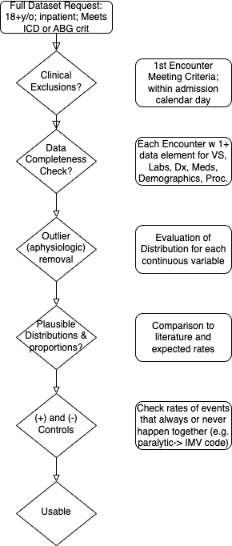
Methods: Data Processing
Problem for our study
Mechanisms of Data Missingness:
E.g. Diagnoses
For a given encounter, the institution must have submitted some data (any data) for each of the data elements requested.
Data validation measures:
Positive controls: e.g if dx of Pna, expect abx Rx
Negative controls: <BMI 30 in OHS
True (patho)physiologic state
What the clinician recognizes
What the clinician documents
What information is structured
What data is aggregated in TriNetX
Missing data here is part of what we want to study
Notes:
Perhaps go through and give metrics for how much the original data varied from this: https://www-ncbi-nlm-nih-gov.ezproxy.lib.utah.edu/pmc/articles/PMC5051581/ ←- different categories/metrics of data quality
BMI: 10-100 - BMI is truncated at 50 to avoid identifying notable patients.
RR: 2-75 --- // whats going on with respiratory rates below 4? - do we think these are coding errors or peri-arrest? — seems like they are preferentially in the ventilation procedure code group… perhaps this is an error in how IMV vs spontaneous breaths are coded in the dataset? I think nothing to do here yet.
Temp(F): 30 - 110
Sys BP: 30 - 350
Dia BP: (15 on revamp) 20 - 250
SpO2: 50-100
HR: 15 - 300
Temp: outside 70F - 110F; 20c - 43c
*** If temperature is between 20-43, can be assumed to represent C and converted to Fahrenheit
Example methods discussion from supplement here: https://www.ncbi.nlm.nih.gov/pmc/articles/PMC8404019/)
“Step I. Data preprocessing
To ensure data quality and hypothesis of clustering algorithm was satisfied, the following preprocessing steps were performed:
(1) data cleaning
Data cleaning was performed on vital monitoring and lab result data to filter out erroneous measurement and correct unsuccessful default data conversion. We examined the statistics and distribution plot of selected clinical variables and FiO2 which were used in calculation of PaO2/FiO2 ratio (P/F ratio). Erroneous measurement such as pH < 6 were removed from the dataset. Additional data conversion was performed on entries where the default data conversion is unsuccessful. For example, bicarbonate measure recorded as “>45” was converted to 45 and age recorded as “>89” was converted to 89. For calculation of P/F ratio, if multiple arterial blood gas test (ABG test) results were recorded at same timestamp with different FiO2 settings, P/F ratio were marked as missing value since we were unable to map PaO2 measurements to corresponding FiO2 ventilator settings.
(2) distribution transformation
We examined skewness and distribution plot of selected variables and applied log transformation on variables with long trails (e.g. Blood Urea Nitrogen, Creatinine).
(3) extreme value bounding
Due to clustering algorithms are sensitive to outliers, we bounded all measurements to their 0.02 and 0.98 percentile respectively to eliminate erroneous and extreme values.
(4) normalization
Normalization was performed for each variable. Categorical variables are encoded by 0 and 1.
(5) removing observations with missing variables
Large number of missing values indicate high degree of information loss. To ensure observations in eICU derivation cohort contains adequate information for clustering, all patients with 10 or more missing variables were removed.
(6) missing value imputation
We observed missing values in eICU dataset under different variable extraction window.¹ Due to clustering algorithm did not accept missing value as input, data imputation is required. We assumed: variables are missing at random (MAR). Multiple imputation by chained equations (MICE) was applied to the dataset and all clinical variables were modeled by linear regression.^{2,3} MICE generated 10 independent datasets in the imputation procedure. For visualization, the last imputed dataset was selected to generate plots. For modelling, standard clustering was performed on each of the imputed datasets, and their parameters were pooled to obtain the final model.
(7) correlation analysis
Correlation matrix of selected clinical variables was analyzed.
Step II. Understanding the clustering structure
Data points can group in non-overlapping balls with clear boundaries in between or group in one ball that can be partitioned into multiple subgroup in high dimensional space. To understand the grouping structure of points, we applied a clustering algorithm called ordering points to identify the clustering structure (OPTICS).⁴ OPTICS is a density-based model which can detect clusters in various densities. A reachability plot was produced with OPTICS, which was used to determine if data points are group in non-overlapping balls. If the reachability plot consists multiple segmented curves with points on the tail of one curve significantly higher than most points on another curve, points in the underlying dataset are likely group in non-overlapping balls. If the reachability plot consists one smooth curve, points in the underlying dataset are likely to group in one ball. The reachability plot for both eICU derivation and validation cohort were smooth curves, indicating that points were grouped in one ball and that partition clustering model was preferred.
Step III. Clustering
We used centroid based K-means clustering (K-Means) as the clustering model in this study. To determine the optimal number of cluster k, we examined the Gap statistics and the Gap* statistics. Consensus clustering (CC) is used the cross validation the cluster assignment of K-Means.
To evaluate the clustering result, we considered both theoretical and practical factors including: (1) Goodness of fit (2) Adequate large cluster size (3) Salient difference in clinical characteristics between different phenotypes. Phenotypes were visualized by: (1) t-distributed stochastic neighbor embedding plots (t-SNE)⁵ (2) Line plot of variables normalized by 3 phenotype population mean (3) Rank plot of variables normalized by 2 phenotype population mean.
The optimal number of cluster k is determined by the Gap statistics and the Gap* statistics. Gap statistic compares the total intra-cluster variation for number of cluster k with their expected values under the null hypothesis that distribution has no obvious cluster and is calculated as log of Intra-cluster sum of the pairwise distances.⁶ The difference between Gap statistics and Gap* statistics is that Gap* statistics remove the log function.⁷ In some cases, Gap statistics tend to overestimate the number of clusters but may outperform in the overlapping group cases. In these cases, the optimal number of cluster is determined by the highest Gap statistics value or identifying the first number of cluster k, such that Gap_{n}(k) ≥ Gap_{n}(k + 1) − s_{k+1}. Both Diff value in Gap statistics plot and Gap* statistics plot suggested that optimal number of clusters is 3.
To cross validate the cluster assigned by K-Means, we applied consensus clustering on same data to compare the difference in cluster assignments and phenotype clinical characteristics. Consensus clustering aims to group points into clusters by evaluating degree of confidence or “consensus” of two points are grouped into one cluster under the uncertainty of repeated subsampling.⁸ Pairwise consensus value is defined as “the proportion of time in which two point are grouped in the same cluster” and a high consensus value indicates high goodness of fit. We performed consensus clustering under the ConsensusClusterPlus implementation in R.⁹ We observe a sharp decline in Delta Area plot of CDF from 3 class to 4 class, indicating optimal number of clusters is likely to be 3. Under cluster number=3, cluster consensus for all cluster was above 0.8 and consensus matrix plot suggested that goodness of fit was high.
To further test the stability and robustness of K-Means model, we evaluated the following factors: (1) changes in clinical characteristics of phenotypes between models trained on eICU derivation cohort and eICU validation cohort (2) variance of fitted parameters on multiple imputed datasets by MICE (3) changes in clinical characteristics of each phenotype by altering the clinical variable extraction window from +/-8 hours to +/-12 and +/-24 hours. The clinical characteristics of phenotype generated by K-Means were stable cross all the above tests.
“

Slide 20
Results: Cohort Description
Final cohort: 119,816
‘Missing’ Data Rates:
ABG: 30%; VBG 70%
BMP, CBC elements 3%
Triage VS: 30% (BP) -70% (SpO2)
Control outcomes:
Receive paralytic → IMV code? 80% (OR?)
AECOPD/Asthma → Systemic Steroid? 88%
Pneumonia dx code → CAP Antibiotic? 81%
56% have critical care services billed
52% with acidemia (<7.35 pH); higher likelihood of critical care (OR 1.77)
CHF (OR 0.82) and OSA (OR 0.93) less likely acidemic
COPD (OR 1.16), CKD (1.21), and OUD (1.10) more likely

Slide 21
Overlap between definitions

Slide 22
How do the patients differ?
 | Total | Chung 2021 | Meservey 2020 | Adler 2016
 | N=119,816 | N=104,253 | N=30,414 | N=18,143
Age | 61 (±16) | 61 (±16) | 62 (±15) | 60 (±16)
Female? | 43% (51,315) | 42% (43,975) | 48% (14,506) | 40% (7,192)
Black | 19% (22,824) | 19% (20,041) | 19% (5,917) | 19% (3,513)
Latino | 7% (6,867) | 7% (6,027) | 6% (1,565) | 9% (1,376)
BMI | 30 (±8) | 29 (±7) | 31 (±9) | 30 (±8)
CHF | 13% (15,655) | 13% (13,126) | 23% (6,936) | 19% (3,435)
COPD | 21% (24,961) | 20% (20,649) | 31% (9,576) | 21% (3,897)
Neuromuscular Disease | 3% (3,619) | 3% (2,933) | 4% (1,173) | 3% (507)
OSA | 20% (24,446) | 19% (19,698) | 28% (8,568) | 19% (3,488)
Opiate Use Disorder | 4% (4,354) | 3% (2,955) | 4% (1,343) | 4% (696)

Slide 23
How do the physiology and management differ?
 | Total | Chung 2021 | Meservey 2020 | Adler 2016
 | N=119,816 | N=104,253 | N=30,414 | N=18,143
Acidosis by ABG or VBG? | 59% (51,546) | 60% (47,282) | 62% (11,741) | 64% (9,151)
Bicarbonate | 25 (±6) | 25 (±6) | 27 (±7) | 24 (±7)
Critical Care Services | 40% (47,500) | 39% (40,176) | 54% (16,467) | 100% (18,143)
CPAP proc. code | 9% (10,777) | 8% (8,803) | 16% (5,002) | 17% (3,172)
Procedure code for NIV (not nightly CPAP) | 12% (14,296) | 11% (11,328) | 25% (7,474) | 23% (4,224)
Procedure code for IMV | 39% (46,222) | 39% (40,337) | 46% (14,051) | 89% (16,088)
Length of Stay | - | - | - | -
In Hospital Mortality | - | - | - | -

Slide 24
Who do guidelines apply to?
Based on diagnostic codes present
ATS OHS* Guideline (2019):
Obesity with Hypoventilation Dx: 4,839 (4%)
Obese and no COPD/Asthma/CHF/NMD/OUD Dx: 62,400 (51%)
Missing data…
Obese and OSA and no COPD/Asthma/CHF/NMD/OUD dx: 7,538 (6%)
ATS COPD NIV Guideline (2020): 9,659 (9%)
Neither guideline: 40-87%

Slide 25
Can we identify relevant physiology?
COPD
COPD
Conditional Probability the Dx is Present
OSA
OSA
OUD
OUD
TODO:
Principal Component Analysis: most parsimonious set of variables that explains how patients with hypercapnia differ from each other
Clustering on this vs. expert features (can’t vs won’t breathe; compensation etc.)
→ physiologic endotypes?
Notes:
Generate by PaCO2 Level
3d stratify for 2 covariates at a time.
Not heatmap, but with AGE/BMI
Goal: Show BMI effect on hypercapnic respiratory failure (severity)
Look at people without another diagnosis (except allow OSA) and see what BMI likelihood is ===> presumptive OHS
Look at conditional probabilities of needing respiratory support
Gets at the question of utilization: would thin w COPD be more likely to need NIV
AGE & BMI -> CO2 graph.
w/ COPD, w/ CHF
Outcomes: critical care services, non-invasive ventilation.

Slide 26
Strengths and Limitations
What does ”big data” get you?
Less susceptible to idiosyncratic local patterns; maybe increased representativeness
Power for subgroup investigations
Data hungry algorithms*
All single-encounter data (cross-sectional) due to data quality
Can’t evaluate readmissions, mortality, subsequent outpatient management.
Data quality: contingent on local practices (hard to assess)
Doesn’t include patients where ABG wasn’t ordered or Dx not given\
Inferences about underlying true physiology much less robust than inferences about coding practices and inclusion criteria due to secondary use data.

Slide 27
Take aways:
Multiple etiologic causes contribute to hypercapnia in many cases and further research is needed to guide how to address high rates of morbidity and mortality.
Rationale exists that current tools (e.g. PAP; or rehab, acetazolamide, etc) could be utilized
Different Cohort definitions do select non-overlapping and clinically different subsets
These cohorts differ in comorbidity distribution and physiology → treatment responsiveness and prognosis?
Therefore, the interpretability of future research might be improved with agreed-upon definitions
Next step: How should we identify patients with hypercapnic respiratory failure

Slide 28
Next steps: How should we identify patients?
Request TriNetX dataset including:
*Patients with hypercapnic RF (ICD, PaCO2)
Patients a reasonable clinician might suspect to have hypercapnic RF
Other respiratory failure + predisposing condition (e.g. NMD)
+VBG CO2 over 48 mmHg
Severe Obesity and elevated bicarbonate
…etc
Model: predictive abilities of feature (or their combinations)
Output: Usable by researchers
Accuracy vs Usability (NLP?)
Binary output vs Probability?
 | ICD Hypercap code and ABG CO2 > 45 | ICD Hypercap code and only VBG w CO2 > 48
 | N=19,093 | N=10,018
Age | 63 (±15) | 61 (±16)
Location
midwest | 21% (3,919) | 13% (1,331)
northeast | 25% (4,705) | 21% (2,143)
south | 46% (8,806) | 32% (3,233)
west | 9% (1,663) | 33% (3,311)
BMI | 30 (±8) | 32 (±9)
CHF | 26% (4,913) | 18% (1,789)
COPD | 33% (6,300) | 30% (2,974)
Neuromuscular Disease | 3% (655) | 5% (452)
OSA | 25% (4,854) | 34% (3,381)
Pre-test Odds * LR (Strength of Evidence) = Post-test Odds
Notes:
Want similar to select patients in whom a good clinician might suspect hypercapnia
‘spectrum bias’
Any more rigorous way to come up with these criteria than just make them up?
End goal: usable definition –
E.g. NLP, more data features = increase accuracy, decrease usability
With an enriched dataset, you can validate simpler definitions to more complex ones
E.g. can you be sufficiently accurate enough with NCUP-readmissions database features?
Boot strapping problem:
-- dataset provides a sand-box to try different definitions
Generate a probability of Hypercapnia being present, vs dichotomizing.

Slide 29
The Issue of The Reference Standard
No Free Lunch: Except for measuring, all methods rely on assumptions
Formulation as a missing data problem
Withold ABG results and perform supervised learning on those with ABGs
Model propensity to obtain P(ABG) and generated Inverse Probability Weights
Assumptions not met, but would it be better?
Classification (Hypercapnia vs not) → Prediction (risk of hypercapnia-morbidity)
Validate sparse definition to richer data-set
How well can you do with data elements available in NCUPS Readmission Db?
Prospective: Also allows for
Bridges the “documentation to physiology gap”
Allows for more robust assessment of comorbidity status
Nowbar 2004 used ABG → TcCO2 more tolerable?

Slide 30



Questions? Links
Use cases for well-defined computable phenotype:
Improved study enrollment
Improved ascertainment as covariate
Improved outcome (e.g. ambient air pollution)
Hypercapnia Studies (link to github with excel spreadsheet download)
AS Review Lab: AI assisted systematic review
https://asreview.nl/
Mentorship Team:
Krishna Sundar MD (PCCM/Sleep)
Ram Gouripeddi MBBS MSc (Bioinformatics) Jeanette Brown MD PhD (PCCM)
Rob Paine III MD (PCCM)
Wayne Richards BSc (Bioinformatics)
https://trinetx.com/

